Slide 1
Introduction to Scientific Computing
Author: Autar Kaw, Luke Snyder
TEXTBOOK: NUMERICAL METHODS WITH APPLICATIONS

Slide 2
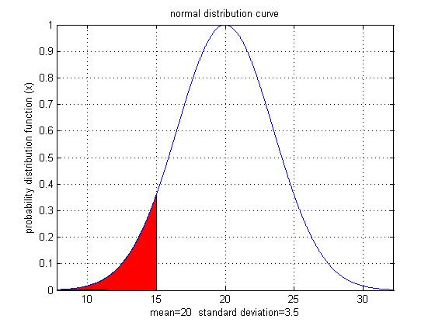
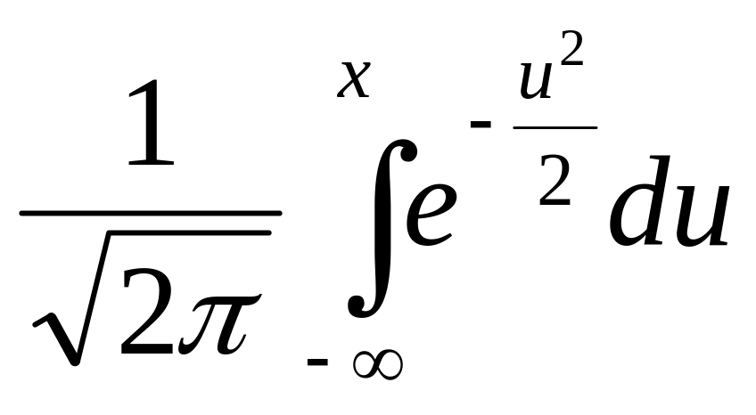
Why use Numerical Methods?
To solve problems that cannot be solved exactly

Slide 3
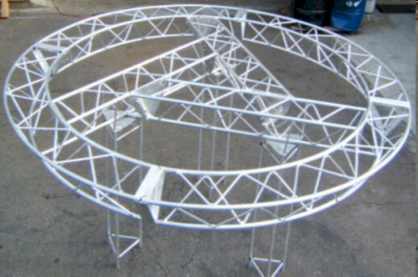
Why use Numerical Methods?
To solve problems that are intractable!
  No efficient algorithm is available

Slide 4
Steps in Solving an
Engineering Problem

Slide 5
How do we solve an engineering problem?
Problem Description
Mathematical Model
Solution of Mathematical Model
Using the Solution

Slide 6
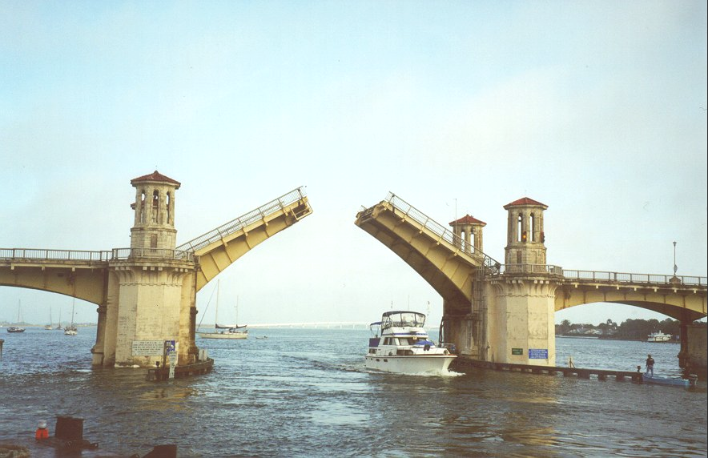
Example of Solving an Engineering Problem
Notes:
Oldest city’s oldest bascule bridge – the Bridge of Lions in St. Augustine, Florida

Slide 7
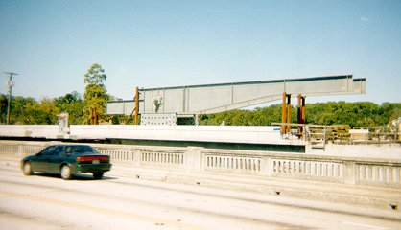
Bascule Bridge THG

Slide 8
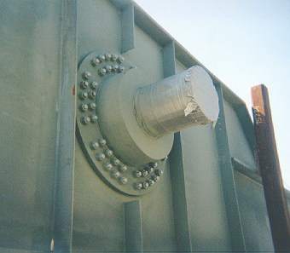
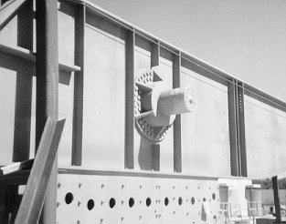
Bascule Bridge THG
Hub
Trunnion
Girder
Notes:
THG picture

Slide 9
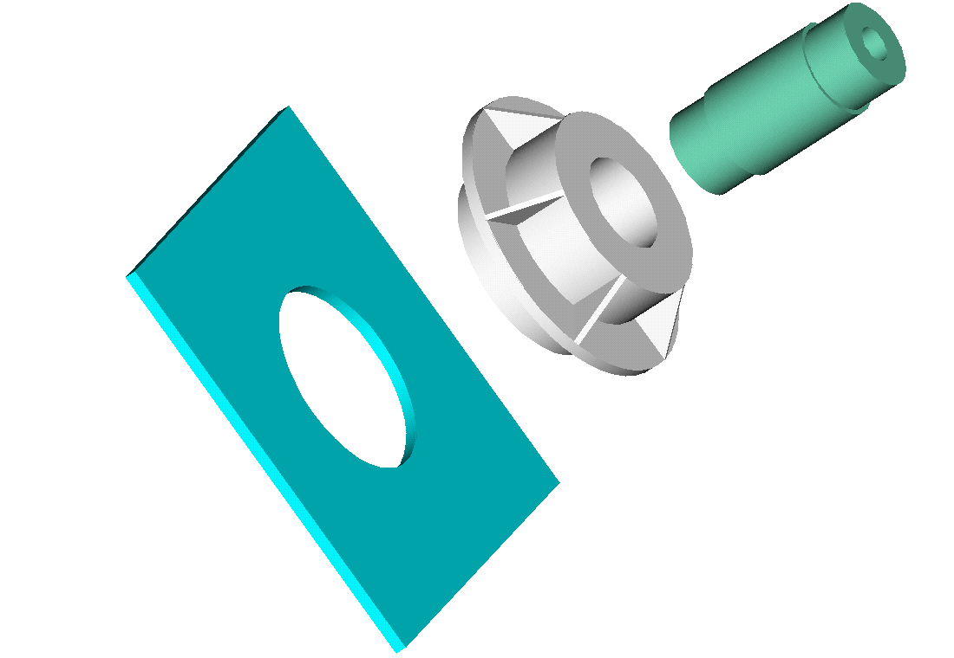
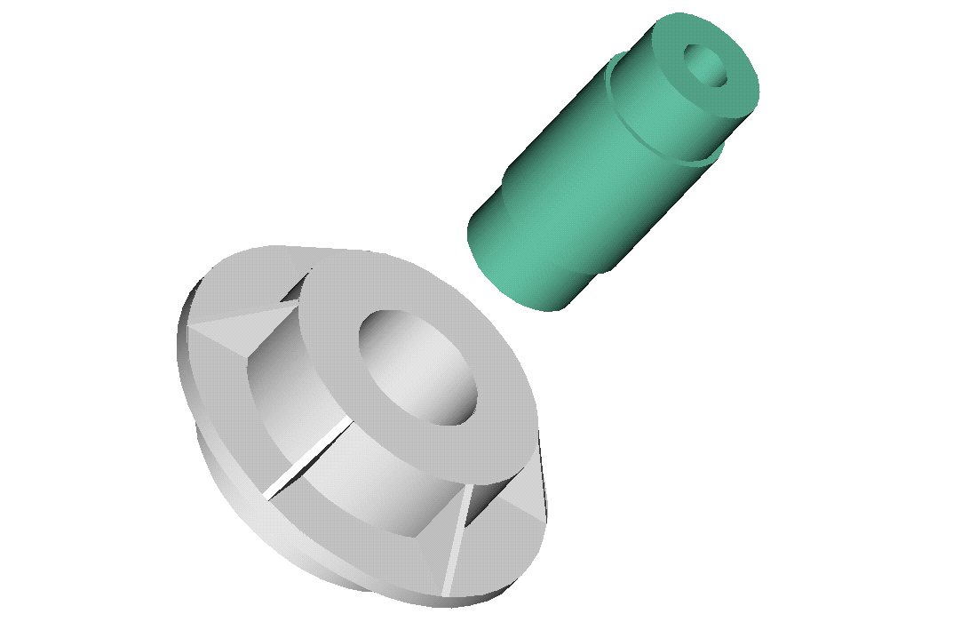
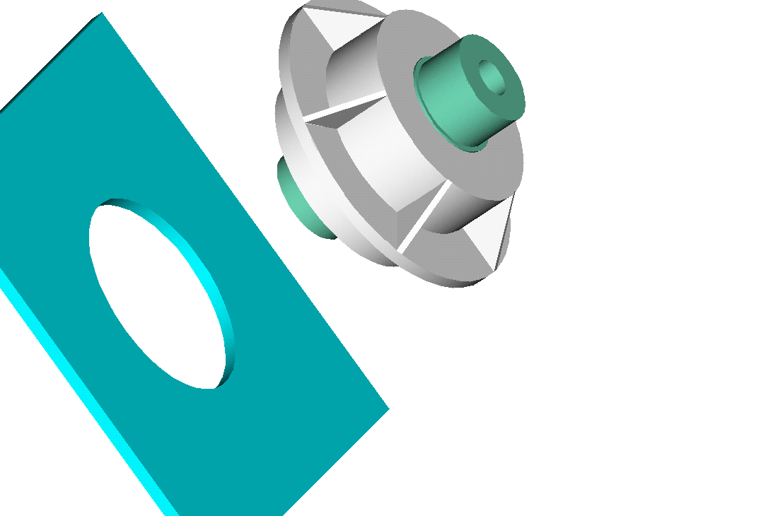
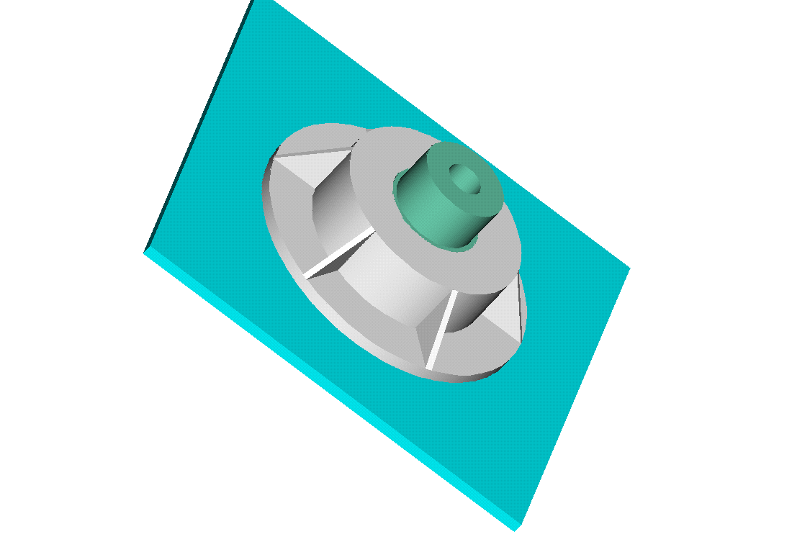
Trunnion-Hub-Girder Assembly Procedure
  Step1. Trunnion immersed in dry-ice/alcohol
  Step2. Trunnion warm-up in hub
  Step3. Trunnion-Hub immersed in
  dry-ice/alcohol
  Step4. Trunnion-Hub warm-up into girder

Slide 10
Problem
After Cooling, the Trunnion Got Stuck in Hub

Slide 11
Why did it get stuck?
Magnitude of contraction needed in the trunnion was 0.015” or more. Did it contract enough?

Slide 12
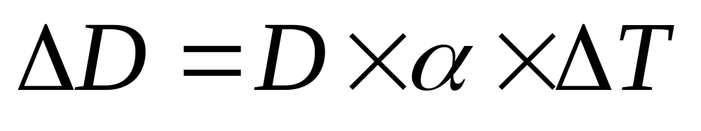
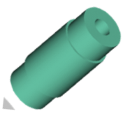
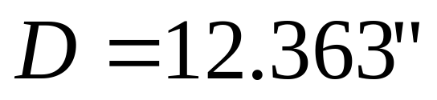
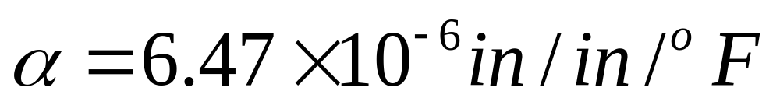
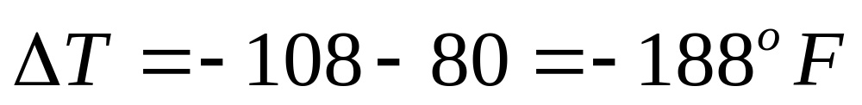
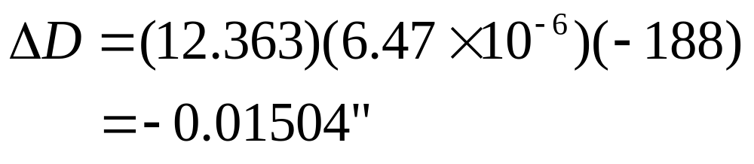
Consultant calculations

Slide 13
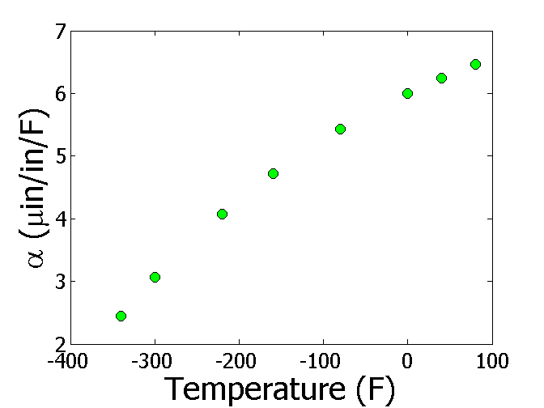

Is the formula used correct?
T(ºF) | α (μin/in/ºF)
-340 | 2.45
-300 | 3.07
-220 | 4.08
-160 | 4.72
-80 | 5.43
0 | 6.00
40 | 6.24
80 | 6.47

Slide 14
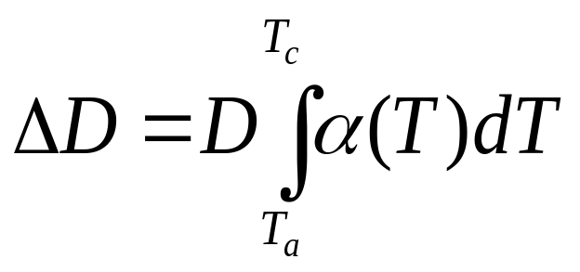
The Correct Model Would Account for Varying Thermal Expansion Coefficient

Slide 15
Can You Roughly Estimate the Contraction?
T_{a}=80ºF; T_{c}=-108ºF; D=12.363”
http://numericalmethods.eng.usf.edu

Slide 16
Can You Find a Better Estimate for the Contraction?
T_{a} = 80ºF
T_{c} = -108ºF
D = 12.363"
http://numericalmethods.eng.usf.edu

Slide 17
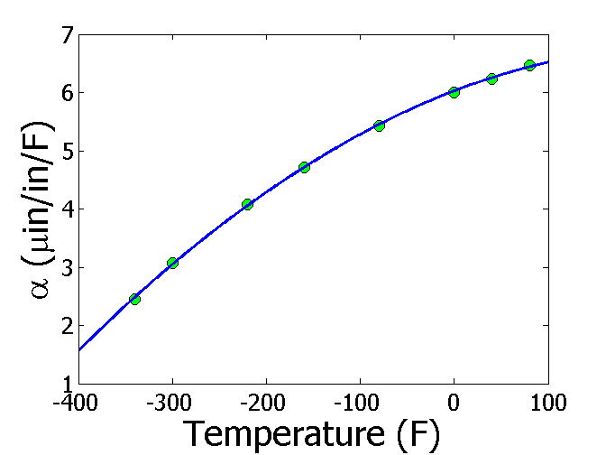
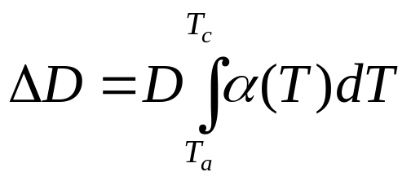
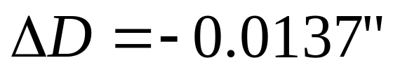
Estimating Contraction Accurately
Change in diameter (ΔD) by cooling it in dry ice/alcohol is given by
T_{a} = 80ºF
T_{c} = -108ºF
D = 12.363"

Slide 18
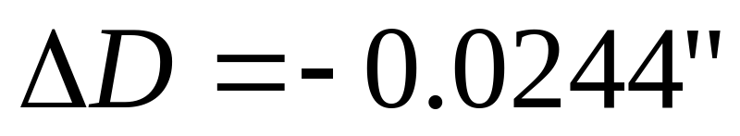
So what is the solution to the problem?
One solution is to immerse the trunnion in liquid nitrogen which has a boiling point of -321ºF as opposed to the dry-ice/alcohol temperature of -108ºF.

Slide 19
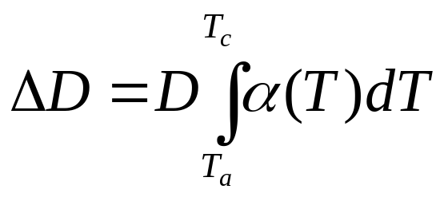
Revisiting steps to solve a problem
1) Problem Statement: Trunnion got stuck in the hub.
2) Modeling: Developed a new model
3) Solution: 1) Used trapezoidal rule OR b) Used regression and integration.
4) Implementation: Cool the trunnion in liquid nitrogen.

Slide 20
Numerical Methods Application to
Mathematical Procedures

Slide 21
Mathematical Procedures
Nonlinear Equations
Simultaneous Linear Equations
Differentiation
Curve Fitting
  Interpolation
  Regression
Integration
Ordinary Differential Equations
Other Advanced Mathematical Procedures:
  Partial Differential Equations
  Optimization
  Fast Fourier Transforms

Slide 22

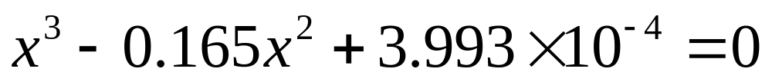
Nonlinear Equations
How much of the floating ball is under water?
Diameter=0.11m
Specific Gravity=0.6

Slide 23
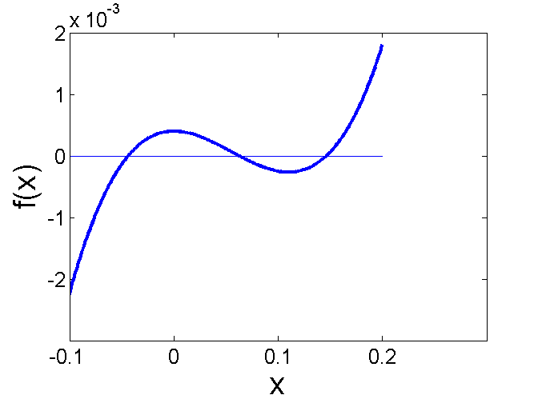
Nonlinear Equations
How much of the floating ball is under the water?

Slide 24
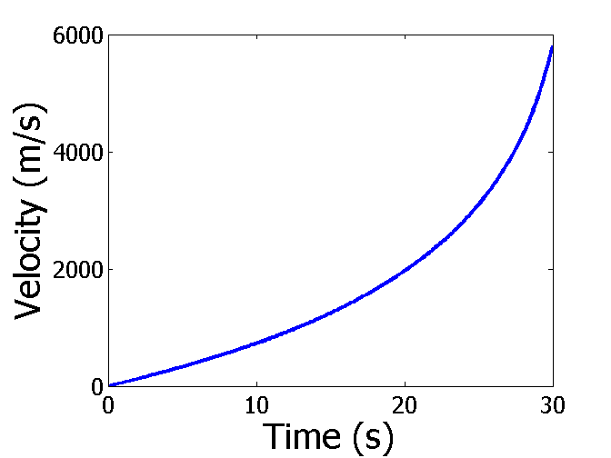

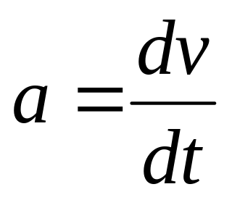
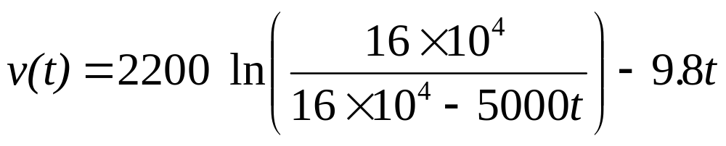
Differentiation
What is the acceleration at t=7 seconds?

Slide 25
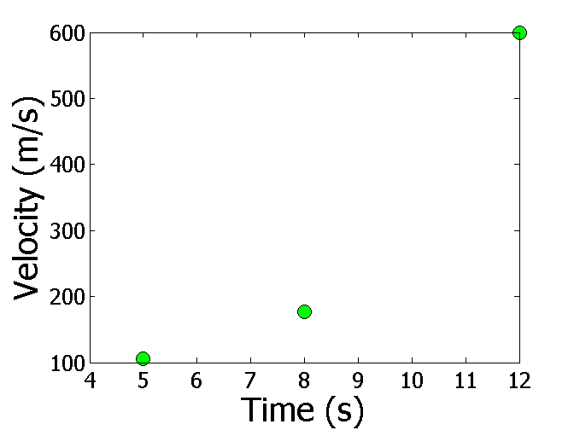
Differentiation
What is the acceleration at t=7 seconds?
Time (s) | 5 | 8 | 12
Vel (m/s) | 106 | 177 | 600

Slide 26
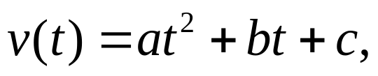

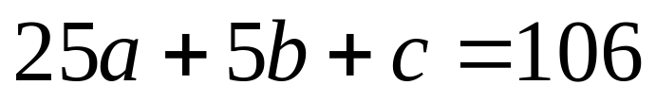
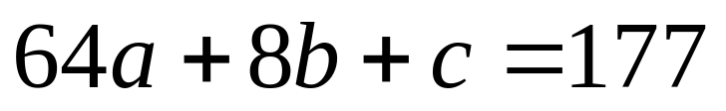
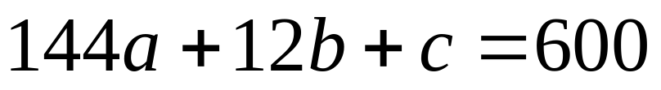
Simultaneous Linear Equations
Find the velocity profile, given
Time (s) | 5 | 8 | 12
Vel (m/s) | 106 | 177 | 600
Three simultaneous linear equations

Slide 27
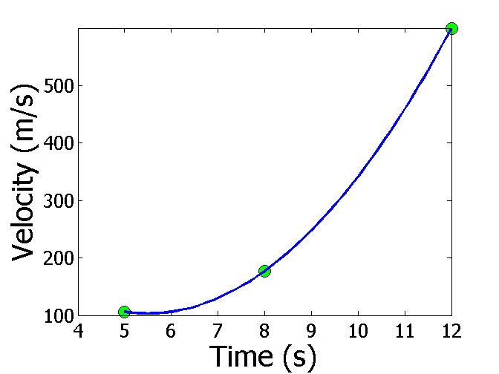
Interpolation
What is the velocity of the rocket at t=7 seconds?
Time (s) | 5 | 8 | 12
Vel (m/s) | 106 | 177 | 600

Slide 28
Regression
Thermal expansion coefficient data for cast steel

Slide 29
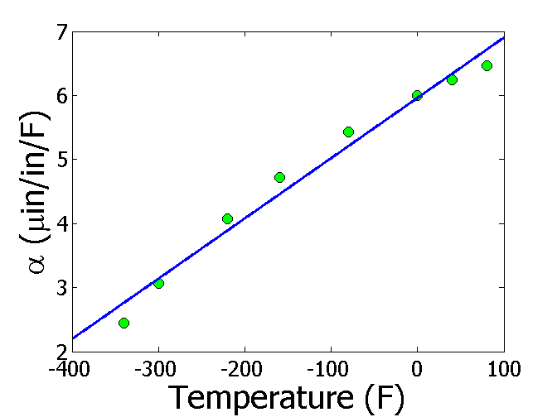
Regression (cont)

Slide 30
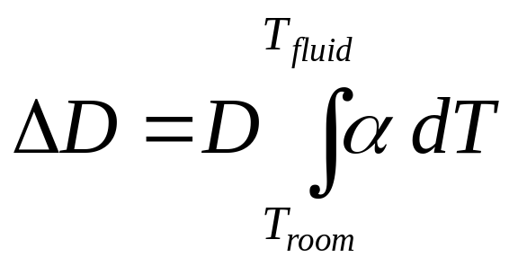
Integration
Finding the diametric contraction in a steel shaft when dipped in liquid nitrogen.

Slide 31
THE END

